Slide 1
Lecture 10:
Recurrent Neural Networks
Fei-Fei Li & Andrej Karpathy & Justin Johnson Lecture 10 - 8 Feb 2016
Lecture 10 -
1

Slide 2
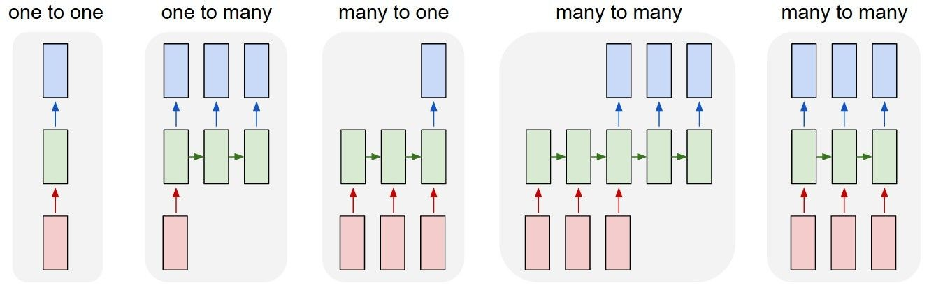
Recurrent Networks offer a lot of flexibility:
Vanilla Neural Networks
Fei-Fei Li & Andrej Karpathy & Justin Johnson Lecture 10 - 8 Feb 2016
Lecture 10 -
6

Slide 3
Recurrent Networks offer a lot of flexibility:
e.g. Image Captioning
image -> sequence of words
Fei-Fei Li & Andrej Karpathy & Justin Johnson Lecture 10 - 8 Feb 2016
Lecture 10 -
7

Slide 4
Recurrent Networks offer a lot of flexibility:
e.g. Sentiment Classification
sequence of words -> sentiment
Fei-Fei Li & Andrej Karpathy & Justin Johnson Lecture 10 - 8 Feb 2016
Lecture 10 -
8

Slide 5
Recurrent Networks offer a lot of flexibility:
e.g. Machine Translation
seq of words -> seq of words
Fei-Fei Li & Andrej Karpathy & Justin Johnson Lecture 10 - 8 Feb 2016
Lecture 10 -
9

Slide 6
Recurrent Networks offer a lot of flexibility:
e.g. Video classification on frame level
Fei-Fei Li & Andrej Karpathy & Justin Johnson Lecture 10 - 8 Feb 2016
Lecture 10 -
10

Slide 7
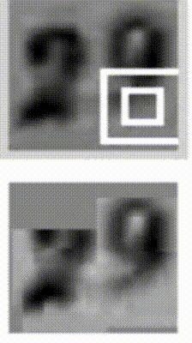
Sequential Processing of fixed inputs
Multiple Object Recognition with Visual Attention, Ba et al.
Fei-Fei Li & Andrej Karpathy & Justin Johnson Lecture 10 - 8 Feb 2016
Lecture 10 -
11
Notes:
Read house number from left to right

Slide 8

Sequential Processing of fixed outputs
DRAW: A Recurrent Neural Network For Image Generation, Gregor et al.
Fei-Fei Li & Andrej Karpathy & Justin Johnson Lecture 10 - 8 Feb 2016
Lecture 10 -
12
Notes:
Draw the house number (not in training data! Made up from the model)

Slide 9
Recurrent Neural Network
RNN
x
Fei-Fei Li & Andrej Karpathy & Justin Johnson Lecture 10 - 8 Feb 2016
Lecture 10 -
13
Notes:
State & input

Slide 10
Recurrent Neural Network
y
usually want to predict a vector at some time steps
RNN
x
Fei-Fei Li & Andrej Karpathy & Justin Johnson Lecture 10 - 8 Feb 2016
Lecture 10 -
14

Slide 11
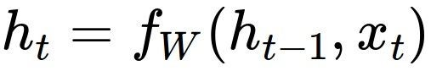
Recurrent Neural Network
We can process a sequence of vectors x by applying a recurrence formula at every time step:
y
RNN
new state
old state input vector at
some time step
some function
with parameters W
x
Fei-Fei Li & Andrej Karpathy & Justin Johnson Lecture 10 - 8 Feb 2016
Lecture 10 -
15
Notes:
F : recurrence function same function every time step

Slide 12
Recurrent Neural Network
We can process a sequence of vectors x by applying a recurrence formula at every time step:
y
RNN
Notice: the same function and the same set of parameters are used at every time step.
x
Fei-Fei Li & Andrej Karpathy & Justin Johnson Lecture 10 - 8 Feb 2016
Lecture 10 -
16

Slide 13

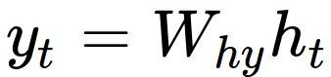
(Vanilla) Recurrent Neural Network
The state consists of a single “hidden” vector h:
y
RNN
x
Fei-Fei Li & Andrej Karpathy & Justin Johnson Lecture 10 - 8 Feb 2016
Lecture 10 -
17

Slide 14
Character-level language model example
RNN
x
y
Vocabulary: [h,e,l,o]
Example training sequence: “hello”
Fei-Fei Li & Andrej Karpathy & Justin Johnson Lecture 10 - 8 Feb 2016
Lecture 10 -
18

Slide 15
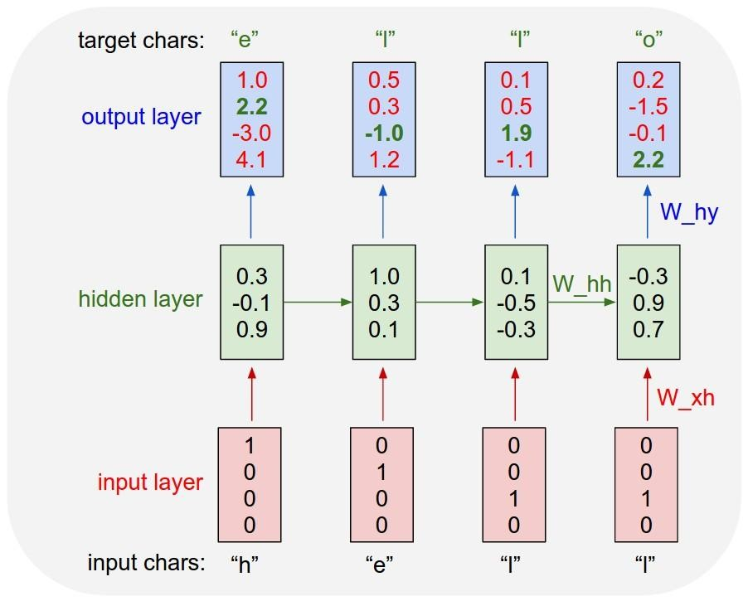
Character-level language model example
Vocabulary: [h,e,l,o]
Example training sequence: “hello”
Fei-Fei Li & Andrej Karpathy & Justin Johnson Lecture 10 - 8 Feb 2016
Lecture 10 -
19

Slide 16

Character-level language model example
Vocabulary: [h,e,l,o]
Example training sequence: “hello”
Fei-Fei Li & Andrej Karpathy & Justin Johnson Lecture 10 - 8 Feb 2016
Lecture 10 -
20

Slide 17
Character-level language model example
Vocabulary: [h,e,l,o]
Example training sequence: “hello”
Fei-Fei Li & Andrej Karpathy & Justin Johnson Lecture 10 - 8 Feb 2016
Lecture 10 -
21

Slide 18
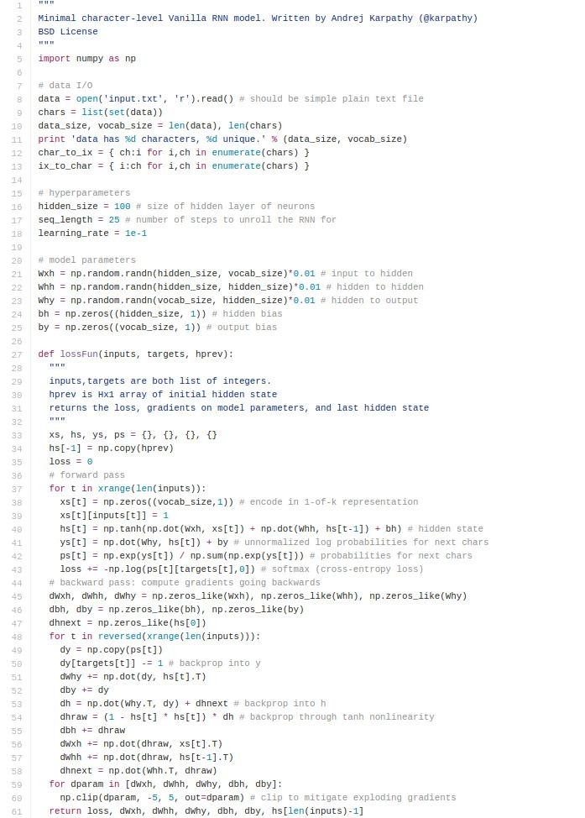
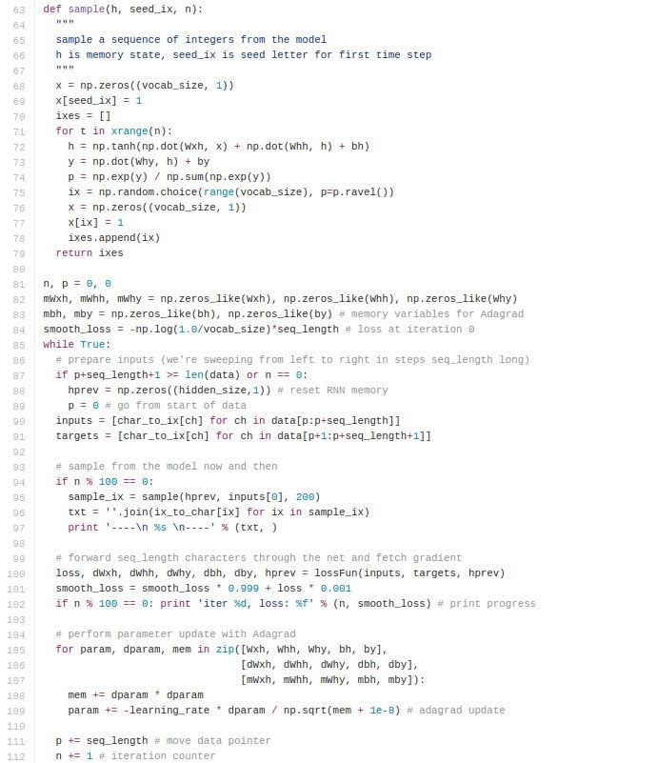
min-char-rnn.py gist: 112 lines of Python
(https://gist.github. com/karpathy/d4dee566867f8291f086)
Fei-Fei Li & Andrej Karpathy & Justin Johnson Lecture 10 - 8 Feb 2016
Lecture 10 -
22

Slide 19
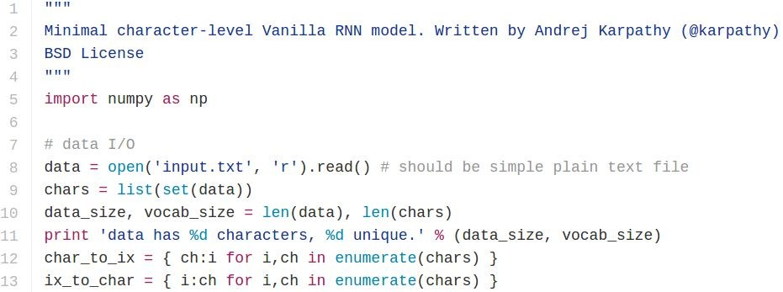
min-char-rnn.py gist
Data I/O

Slide 20
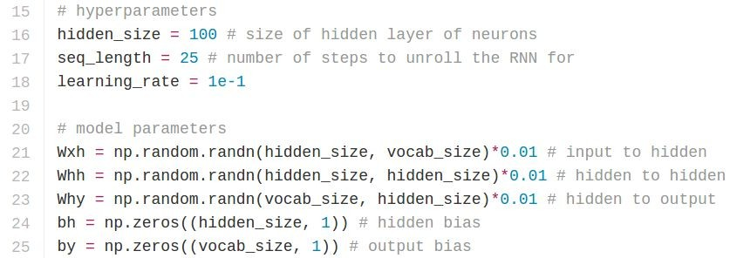
min-char-rnn.py gist
Initializations
recall:

Slide 21
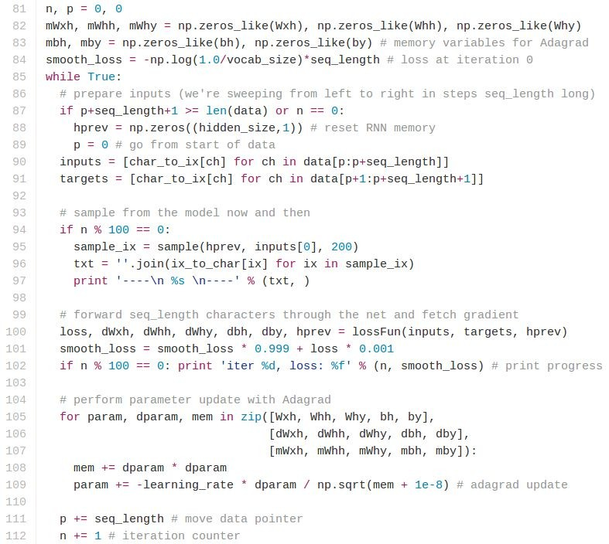
min-char-rnn.py gist
Main loop

Slide 22
min-char-rnn.py gist
Main loop

Slide 23
min-char-rnn.py gist
Main loop

Slide 24
min-char-rnn.py gist
Main loop

Slide 25
min-char-rnn.py gist
Main loop

Slide 26
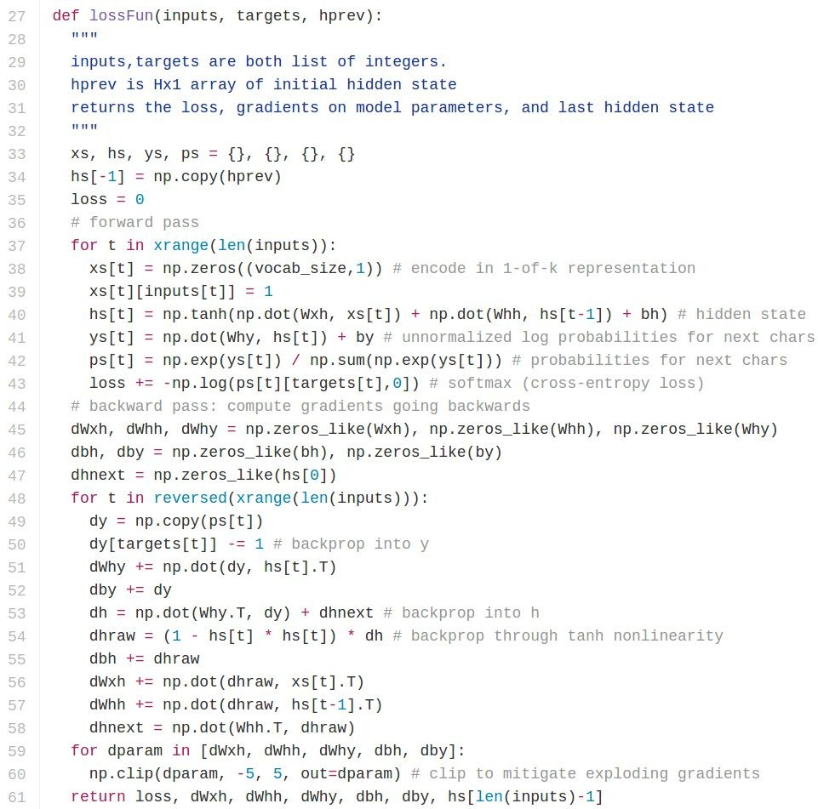
min-char-rnn.py gist
Loss function
forward pass (compute loss)
backward pass (compute param gradient)

Slide 27
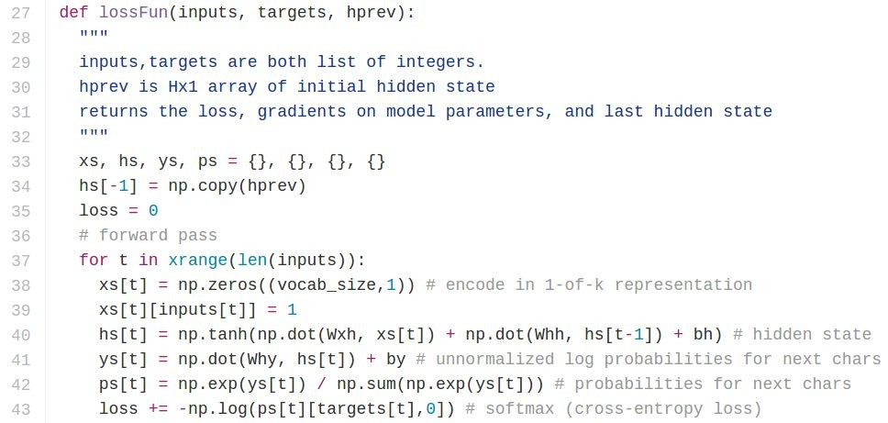
min-char-rnn.py gist
Softmax classifier

Slide 28
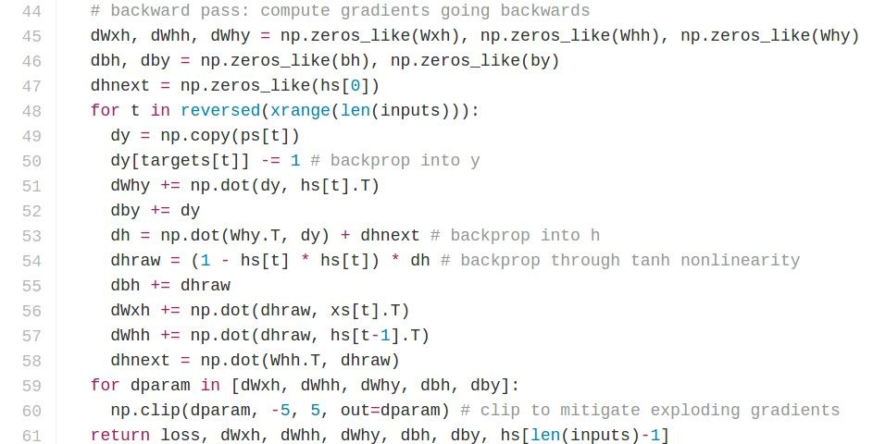
min-char-rnn.py gist
recall:

Slide 29
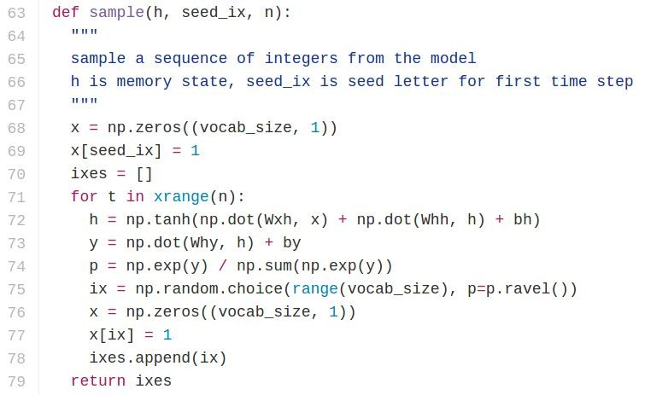
min-char-rnn.py gist

Slide 30
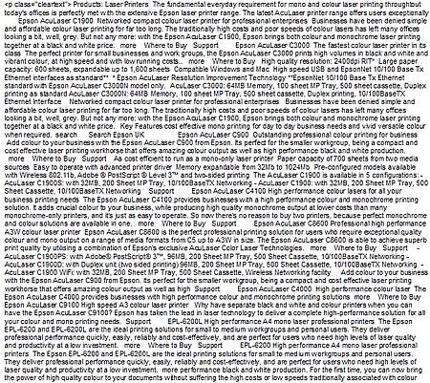
y
RNN
x
Fei-Fei Li & Andrej Karpathy & Justin Johnson Lecture 10 - 8 Feb 2016
Lecture 10 -
34

Slide 31

Fei-Fei Li & Andrej Karpathy & Justin Johnson Lecture 10 - 8 Feb 2016
Lecture 10 -
35

Slide 32

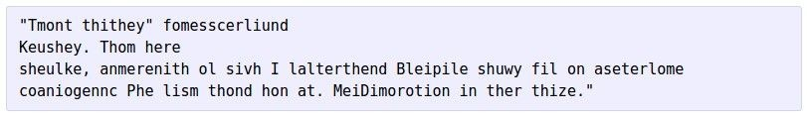
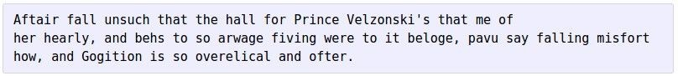
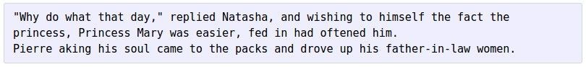
at first:
train more
train more
train more
Fei-Fei Li & Andrej Karpathy & Justin Johnson Lecture 10 - 8 Feb 2016
Lecture 10 -
36

Slide 33
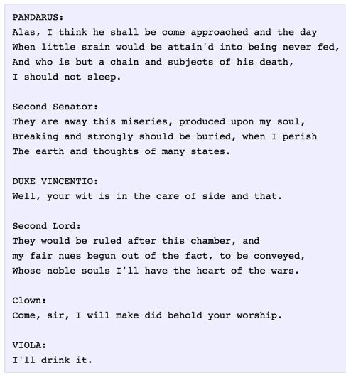
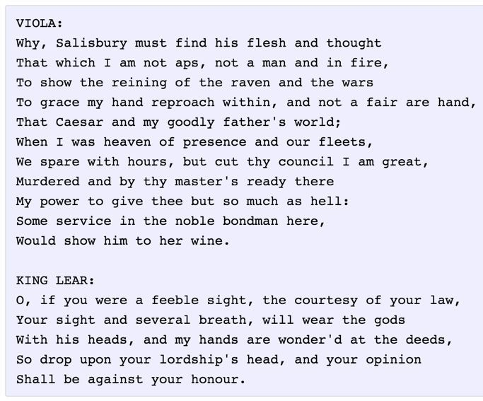
Fei-Fei Li & Andrej Karpathy & Justin Johnson Lecture 10 - 8 Feb 2016
Lecture 10 -
37

Slide 34
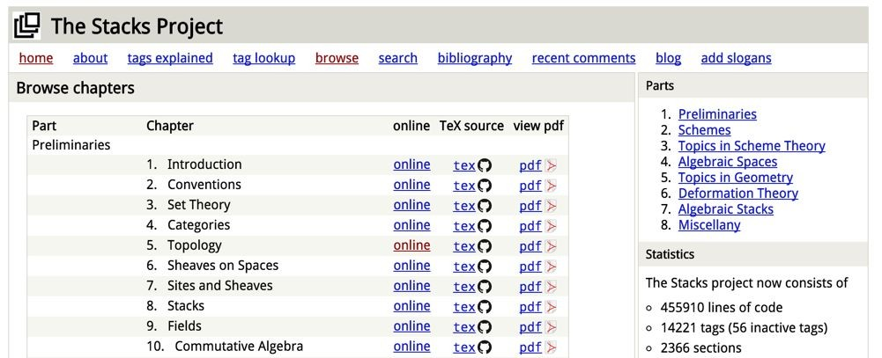
open source textbook on algebraic geometry
Latex source
Fei-Fei Li & Andrej Karpathy & Justin Johnson Lecture 10 - 8 Feb 2016
Lecture 10 -
38

Slide 35
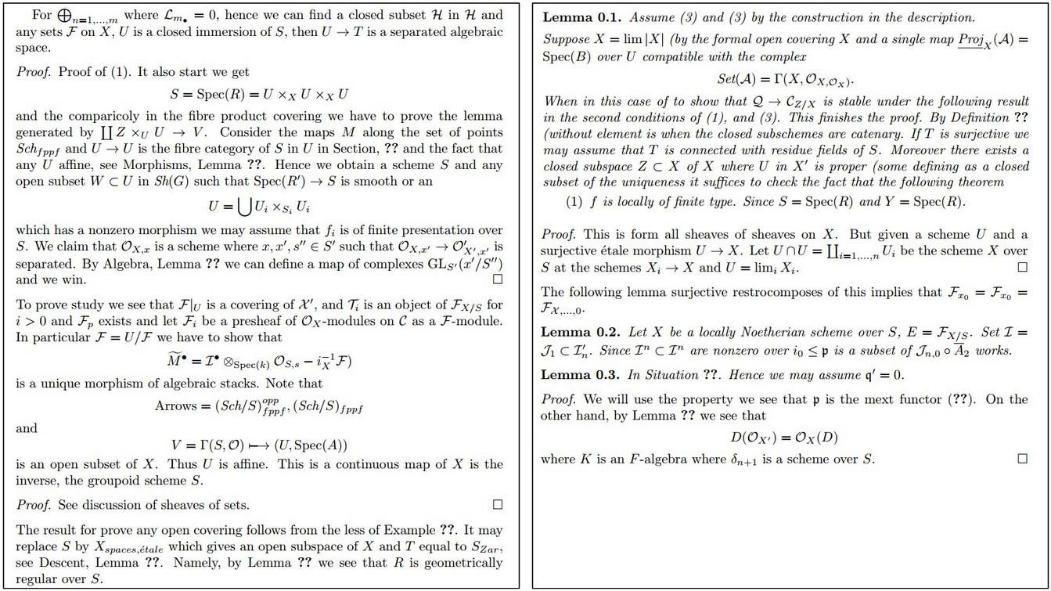
Fei-Fei Li & Andrej Karpathy & Justin Johnson Lecture 10 - 8 Feb 2016
Lecture 10 -
39

Slide 36
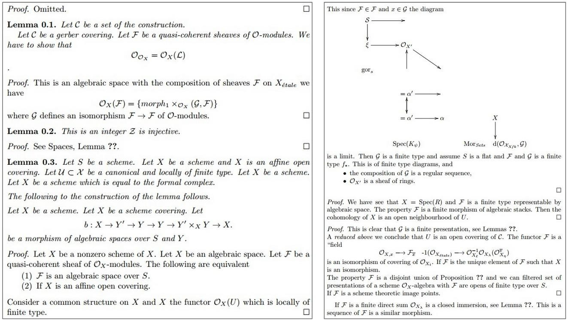
Fei-Fei Li & Andrej Karpathy & Justin Johnson Lecture 10 - 8 Feb 2016
Lecture 10 -
40

Slide 37
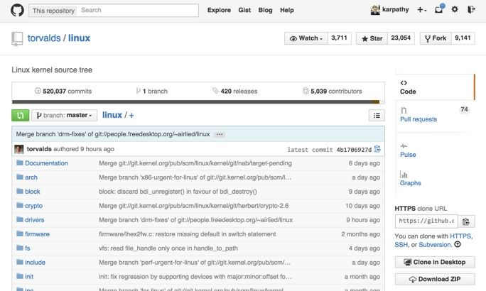
Fei-Fei Li & Andrej Karpathy & Justin Johnson Lecture 10 - 8 Feb 2016
Lecture 10 -
41

Slide 38
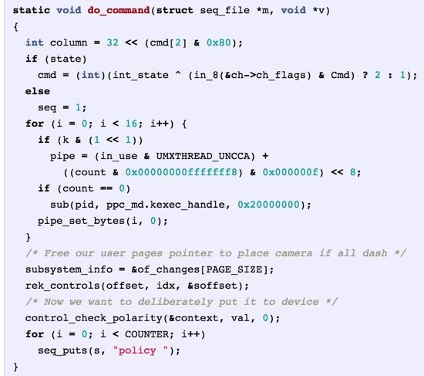
Generated C code
Fei-Fei Li & Andrej Karpathy & Justin Johnson Lecture 10 - 8 Feb 2016
Lecture 10 -
42
Notes:
Declare stuff never using & use stuff never declared

Slide 39
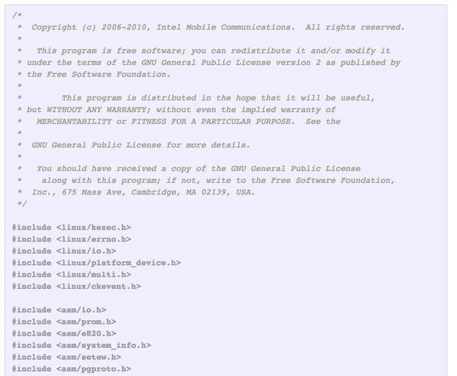
Fei-Fei Li & Andrej Karpathy & Justin Johnson Lecture 10 - 8 Feb 2016
Lecture 10 -
43
Notes:
GPL-license

Slide 40
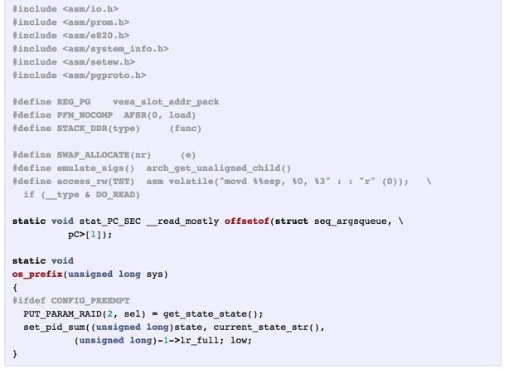
Fei-Fei Li & Andrej Karpathy & Justin Johnson Lecture 10 - 8 Feb 2016
Lecture 10 -
44
Notes:
Three layer of LSTM

Slide 41
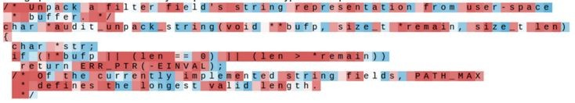
Searching for interpretable cells
[Visualizing and Understanding Recurrent Networks, Andrej Karpathy*, Justin Johnson*, Li Fei-Fei]
Fei-Fei Li & Andrej Karpathy & Justin Johnson Lecture 10 - 8 Feb 2016
Lecture 10 -
45
Notes:
The hidden state excited or not

Slide 42

Searching for interpretable cells
quote detection cell
Fei-Fei Li & Andrej Karpathy & Justin Johnson Lecture 10 - 8 Feb 2016
Lecture 10 -
46
Notes:
<=100 characters generalizes to longer sequences

Slide 43
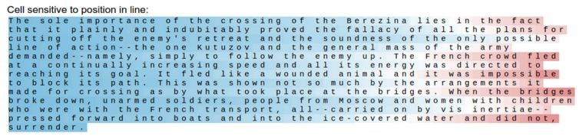
Searching for interpretable cells
line length tracking cell
Fei-Fei Li & Andrej Karpathy & Justin Johnson Lecture 10 - 8 Feb 2016
Lecture 10 -
47
Notes:
80 time steps a new line!

Slide 44
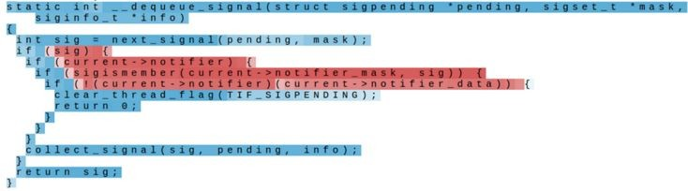
Searching for interpretable cells
if statement cell
Fei-Fei Li & Andrej Karpathy & Justin Johnson Lecture 10 - 8 Feb 2016
Lecture 10 -
48

Slide 45
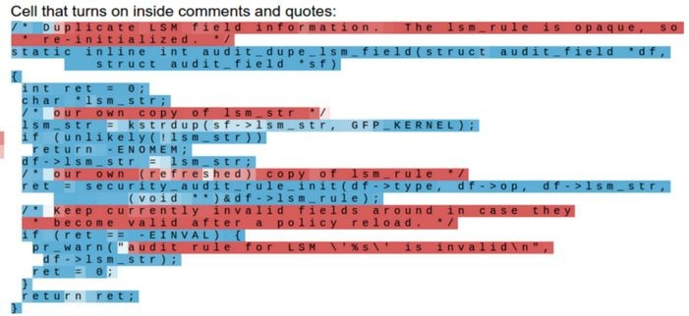
Searching for interpretable cells
quote/comment cell
Fei-Fei Li & Andrej Karpathy & Justin Johnson Lecture 10 - 8 Feb 2016
Lecture 10 -
49

Slide 46
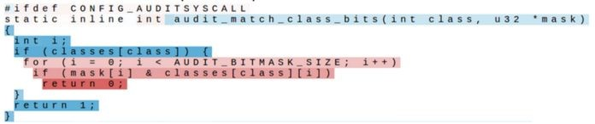
Searching for interpretable cells
code depth cell
Fei-Fei Li & Andrej Karpathy & Justin Johnson Lecture 10 - 8 Feb 2016
Lecture 10 -
50

Slide 47
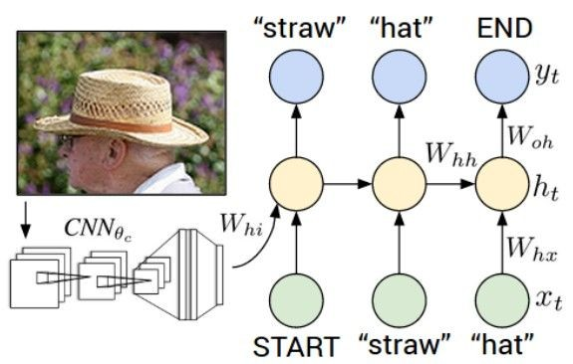
Image Captioning
Explain Images with Multimodal Recurrent Neural Networks, Mao et al.
Deep Visual-Semantic Alignments for Generating Image Descriptions, Karpathy and Fei-Fei Show and Tell: A Neural Image Caption Generator, Vinyals et al.
Long-term Recurrent Convolutional Networks for Visual Recognition and Description, Donahue et al. Learning a Recurrent Visual Representation for Image Caption Generation, Chen and Zitnick
Fei-Fei Li & Andrej Karpathy & Justin Johnson Lecture 10 - 8 Feb 2016
Lecture 10 -
51

Slide 48
Recurrent Neural Network
Convolutional Neural Network
Fei-Fei Li & Andrej Karpathy & Justin Johnson Lecture 10 - 8 Feb 2016
Lecture 10 -
52

Slide 49

test image

Slide 50
test image

Slide 51
test image
X

Slide 52
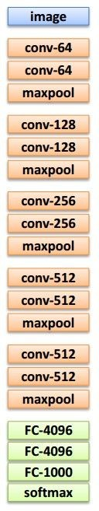
test image
x0
<STA RT>
<START>
Notes:
START:300 dimension, tell RNN it’s the beginning

Slide 53
test image
y0
before:
h = tanh(Wxh * x + Whh * h)
h0
Wih
now:
h = tanh(Wxh * x + Whh * h + Wih * v)
x0
<STA RT>
v
<START>
Notes:
One way to plug in the picture to the RNN

Slide 54
test image
y0
sample!
h0
x0
<STA RT>
straw
<START>

Slide 55
test image
y0
y1
h0
h1
x0
<STA RT>
straw
<START>

Slide 56
test image
y0
y1
sample!
h0
h1
x0
<STA RT>
straw
hat
<START>

Slide 57
test image
y0
y1
y2
h0
h1
h2
x0
<STA RT>
straw
hat
<START>

Slide 58
test image
y0
y1
y2
sample
<END> token
=> finish.
h0
h1
h2
x0
<STA RT>
straw
hat
<START>
Notes:
字符编码

Slide 59

Image Sentence Datasets
Microsoft COCO
[Tsung-Yi Lin et al. 2014]
mscoco.org
currently:
~120K images
~5 sentences each

Slide 60
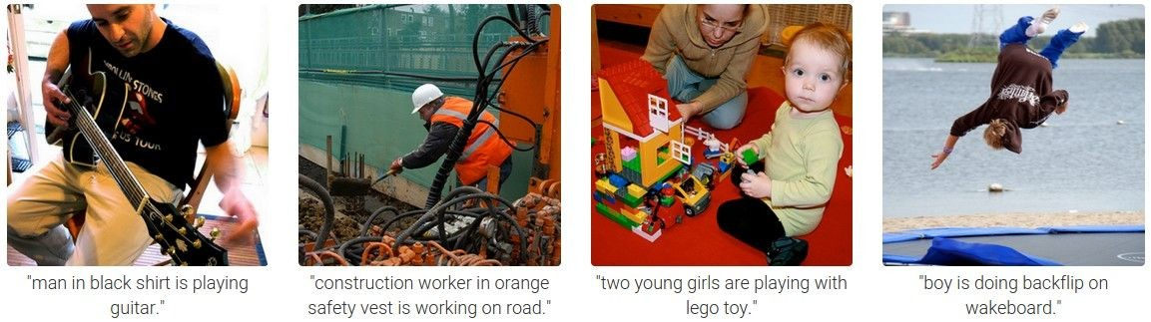

Slide 61
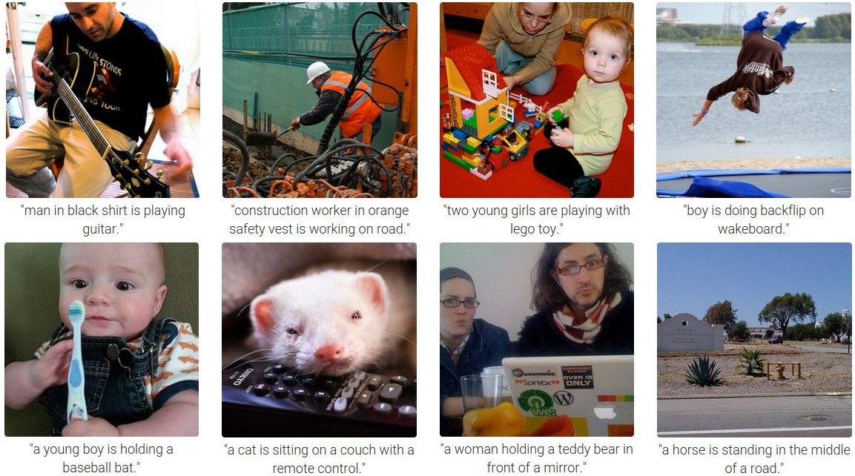

Slide 62
Preview of fancier architectures
RNN attends spatially to different parts of images while generating each word of the sentence:
Show Attend and Tell, Xu et al., 2015
66

Slide 63
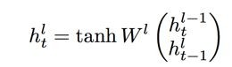



RNN:
depth
time
Fei-Fei Li & Andrej Karpathy & Justin Johnson Lecture 10 - 8 Feb 2016
Lecture 10 -
67

Slide 64

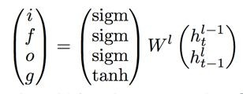
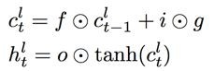
RNN:
LSTM:
depth
time
Fei-Fei Li & Andrej Karpathy & Justin Johnson Lecture 10 - 8 Feb 2016
Lecture 10 -
68

Slide 65
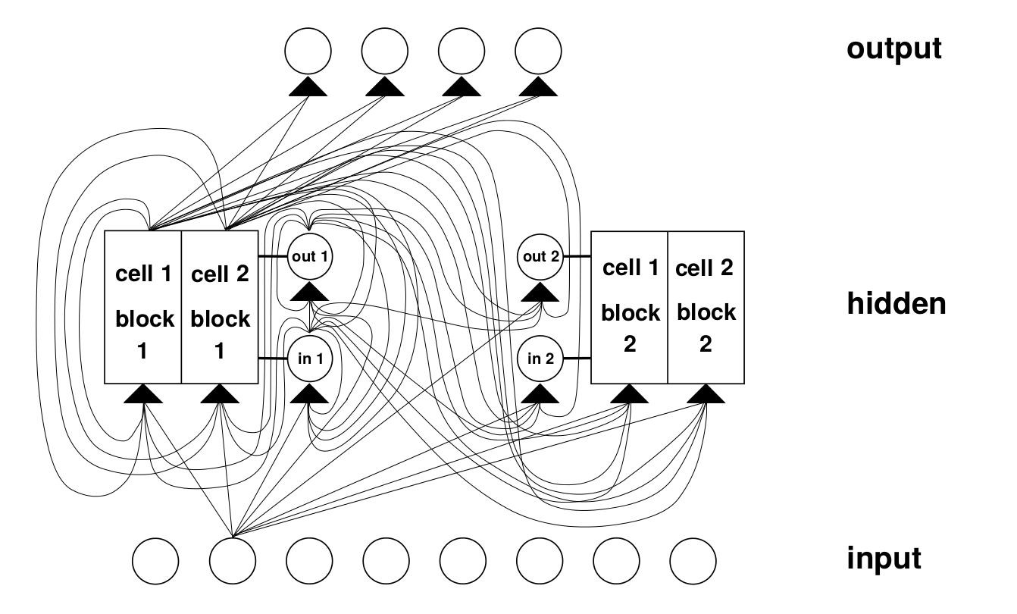
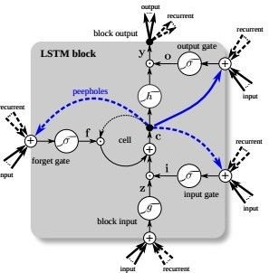
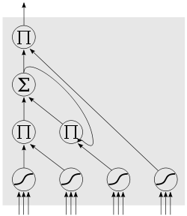
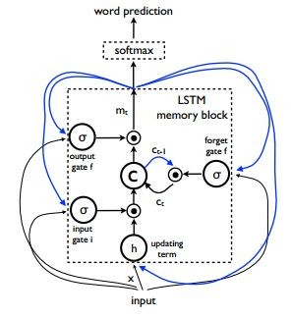
LSTM
Fei-Fei Li & Andrej Karpathy & Justin Johnson Lecture 10 - 8 Feb 2016
Lecture 10 -
69

Slide 66
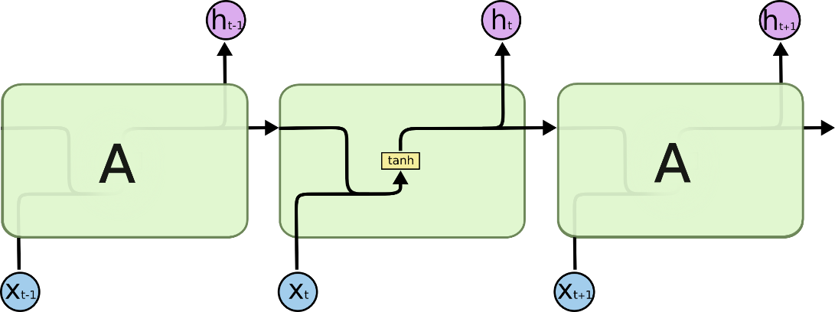
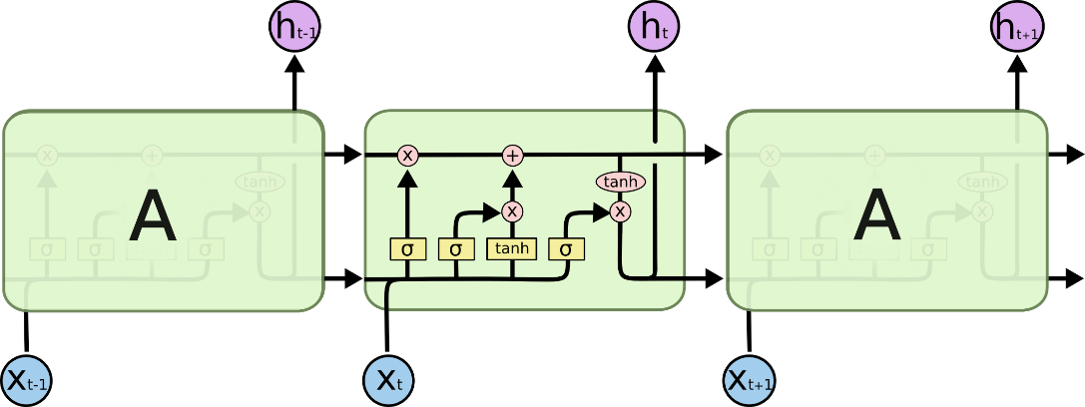
LSTM
RNN
LSTM
Fei-Fei Li & Andrej Karpathy & Justin Johnson Lecture 10 - 8 Feb 2016
Lecture 10 -
70

Slide 67
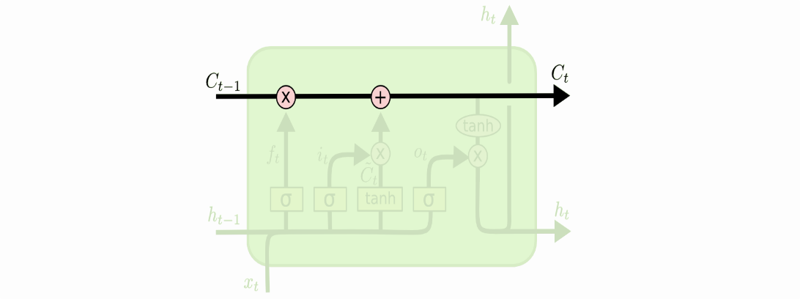
LSTM
The cell state is kind of like a conveyor belt. It runs straight down the entire chain, with only some minor linear interactions. It’s very easy for information to just flow along it unchanged.
Fei-Fei Li & Andrej Karpathy & Justin Johnson Lecture 10 - 8 Feb 2016
Lecture 10 -
70

Slide 68
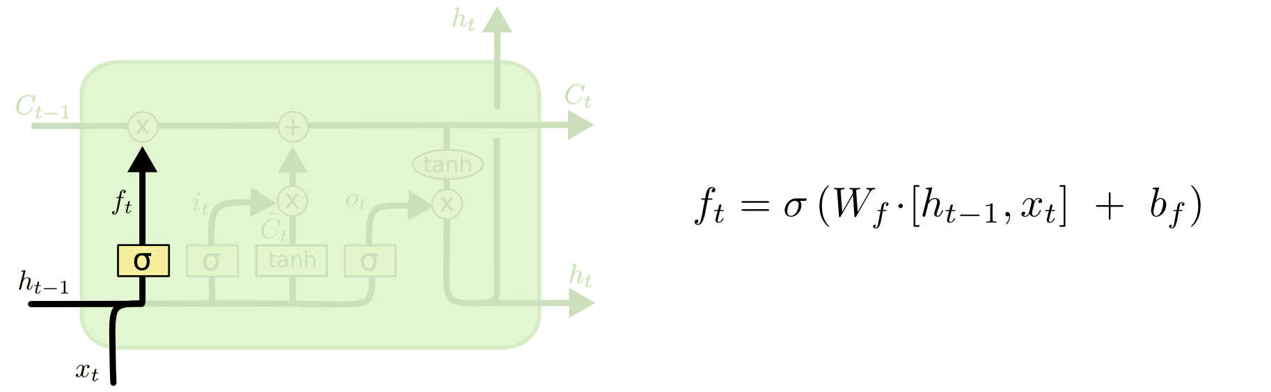
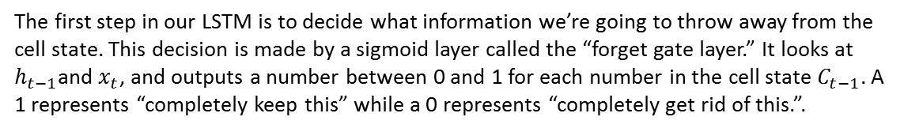
LSTM
The first step in our LSTM is to decide what information we’re going to throw away from the cell state. This decision is made by a sigmoid layer called the “forget gate layer.” It looks at $h_{t−1}$and $x_{t}$, and outputs a number between 0 and 1 for each number in the cell state $C_{t−1}$. A 1 represents “completely keep this” while a 0 represents “completely get rid of this.”.
Fei-Fei Li & Andrej Karpathy & Justin Johnson Lecture 10 - 8 Feb 2016
Lecture 10 -
70

Slide 69
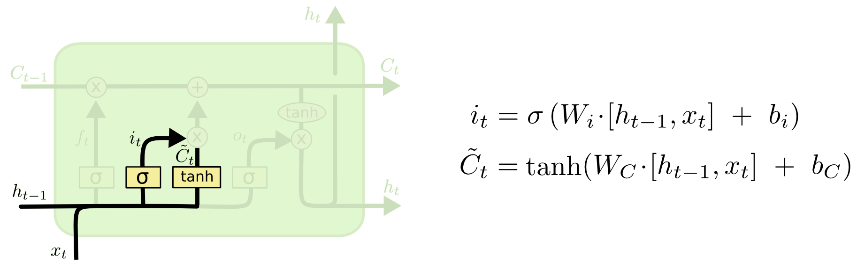
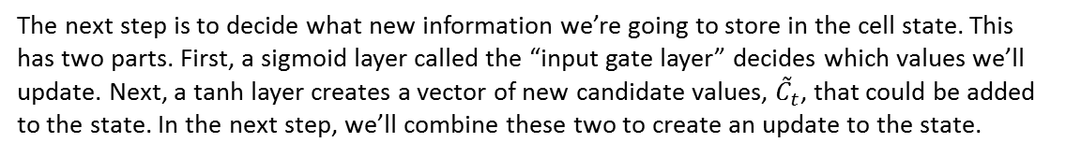
LSTM
The next step is to decide what new information we’re going to store in the cell state. This has two parts. First, a sigmoid layer called the “input gate layer” decides which values we’ll update. Next, a tanh layer creates a vector of new candidate values, ${\tilde{C}}_{t}$, that could be added to the state. In the next step, we’ll combine these two to create an update to the state.
Fei-Fei Li & Andrej Karpathy & Justin Johnson Lecture 10 - 8 Feb 2016
Lecture 10 -
70

Slide 70


LSTM
It’s now time to update the old cell state, $C_{t−1}$, into the new cell state $C_{t}$. The previous steps already decided what to do, we just need to actually do it.
We multiply the old state by $f_{t}$, forgetting the things we decided to forget earlier. Then we add $i_{t}∗ {\tilde{C}}_{t}$. This is the new candidate values, scaled by how much we decided to update each state value.
Fei-Fei Li & Andrej Karpathy & Justin Johnson Lecture 10 - 8 Feb 2016
Lecture 10 -
70

Slide 71

LSTM
Finally, we need to decide what we’re going to output. This output will be based on our cell state, but will be a filtered version. First, we run a sigmoid layer which decides what parts of the cell state we’re going to output. Then, we put the cell state through tanh (to push the values to be between −1 and 1) and multiply it by the output of the sigmoid gate, so that we only output the parts we decided to.
Fei-Fei Li & Andrej Karpathy & Justin Johnson Lecture 10 - 8 Feb 2016
Lecture 10 -
70

Slide 72

GRU – A Variation on the LSTM
A slightly more dramatic variation on the LSTM is the Gated Recurrent Unit, or GRU, introduced by Cho, et al. (2014). It combines the forget and input gates into a single “update gate.” It also merges the cell state and hidden state, and makes some other changes. The resulting model is simpler than standard LSTM models, and has been growing increasingly popular..
Fei-Fei Li & Andrej Karpathy & Justin Johnson Lecture 10 - 8 Feb 2016
Lecture 10 -
70

Slide 73


LSTM variants and friends
[An Empirical Exploration of Recurrent Network Architectures, Jozefowicz et al., 2015]
[LSTM: A Search Space Odyssey, Greff et al., 2015]
GRU [Learning phrase representations using rnn encoder- decoder for statistical machine translation, Cho et al. 2014]
Fei-Fei Li & Andrej Karpathy & Justin Johnson Lecture 10 - 8 Feb 2016
Lecture 10 -
81

Slide 74
state
RNN
f
f
f
f
f
f
LSTM
(ignoring forget gates)
+ + +
Fei-Fei Li & Andrej Karpathy & Justin Johnson Lecture 10 - 8 Feb 2016
Lecture 10 -
76

Slide 75



Recall:
“PlainNets” vs. ResNets
ResNet is to PlainNet what LSTM is to RNN, kind of.
Fei-Fei Li & Andrej Karpathy & Justin Johnson Lecture 10 - 8 Feb 2016
Lecture 10 -
77

Slide 76

Understanding gradient flow dynamics
Cute backprop signal video: http://imgur.com/gallery/vaNahKE
Fei-Fei Li & Andrej Karpathy & Justin Johnson Lecture 10 - 8 Feb 2016
Lecture 10 -
78

Slide 77
Understanding gradient flow dynamics
if the largest eigenvalue is > 1, gradient will explode if the largest eigenvalue is < 1, gradient will vanish
[On the difficulty of training Recurrent Neural Networks, Pascanu et al., 2013]
Fei-Fei Li & Andrej Karpathy & Justin Johnson Lecture 10 - 8 Feb 2016
Lecture 10 -
79

Slide 78
Understanding gradient flow dynamics
if the largest eigenvalue is > 1, gradient will explode if the largest eigenvalue is < 1, gradient will vanish
can control exploding with gradient clipping can control vanishing with LSTM
[On the difficulty of training Recurrent Neural Networks, Pascanu et al., 2013]
Fei-Fei Li & Andrej Karpathy & Justin Johnson Lecture 10 - 8 Feb 2016
Lecture 10 -
80
Notes:
Bias on forget gate

Slide 79
Summary
RNNs allow a lot of flexibility in architecture design
Vanilla RNNs are simple but don’t work very well
Common to use LSTM or GRU: their additive interactions improve gradient flow
Backward flow of gradients in RNN can explode or vanish. Exploding is controlled with gradient clipping. Vanishing is controlled with additive interactions (LSTM)
Better/simpler architectures are a hot topic of current research
Better understanding (both theoretical and empirical) is needed.
Fei-Fei Li & Andrej Karpathy & Justin Johnson Lecture 10 - 8 Feb 2016
Lecture 10 -
82

